Slide 1

Introduction to SQL

Slide 2

Introduction to SQL
SQL (Structured Query Language) is a programming language used to manage and manipulate data stored in a relational database management system (RDBMS).
In simpler terms, SQL is used to interact with databases, retrieve and manipulate data, and perform various operations on the data, such as inserting, updating, and deleting records. It provides a standard way to communicate with databases, making it possible for different software applications to work together.

Slide 3

Why we are using SQL?
SQL is also a powerful language that allows for complex queries, joins, and aggregates, making it useful for a wide range of applications, from small businesses to large enterprises.
SQL is Standard language used by many different database systems…
SQL have the ability to manage large amount of data,easy to use,Data security,flexible and adapted and scalability(fixing the number of users)

Slide 4

Database Connectivity
Database Connectivity can be achieved using different methods, such as using programming languages like SQL or connecting through application programming interfaces (APIs). The use of middleware technologies like ODBC and JDBC can also facilitate database connectivity.

Slide 5
Database Connectivity
To connect to a database using SQL, you need to create a connection string that contains the database server name, database name, username, and password.
Here's an example of a connection string in PHP:
$conn = mysqli_connect("localhost", "username", "password", "database_name");
if (!$conn) {
die("Connection failed: " .mysqli_connect_error());
}
else
{
echo “Connection Successful”;
}

Slide 6

Creating Database
To create a database in SQL, you can use the CREATE DATABASE statement. The CREATE DATABASE statement may include additional parameters such as character set and collation. Here's an example of creating a database named "mydatabase":
Syntax:- CREATE DATABASE mydatabase;
Query:- CREATE DATABASE LakhSingh;

Slide 7
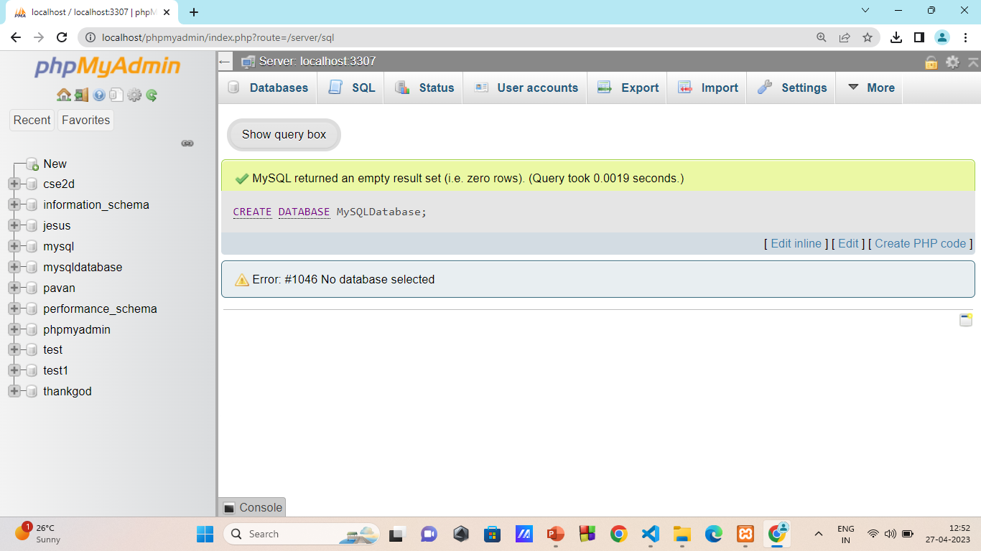
Execution:-

Slide 8


Creating Table
S.No | Student Name | Gender | Age | Ph.no
Not this table
This table

Slide 9

Creating Table
To create a table in SQL, you can use the CREATE TABLE statement. Here's an example of creating a table named “CSE-2D" with columns "id", "name", "email", and "phone":
CREATE TABLE CSE-2D (
id INT(6) UNSIGNED AUTO_INCREMENT PRIMARY KEY,
name VARCHAR(30) NOT NULL,
email VARCHAR(50) NOT NULL,
phone VARCHAR(15) NOT NULL
);

Slide 10
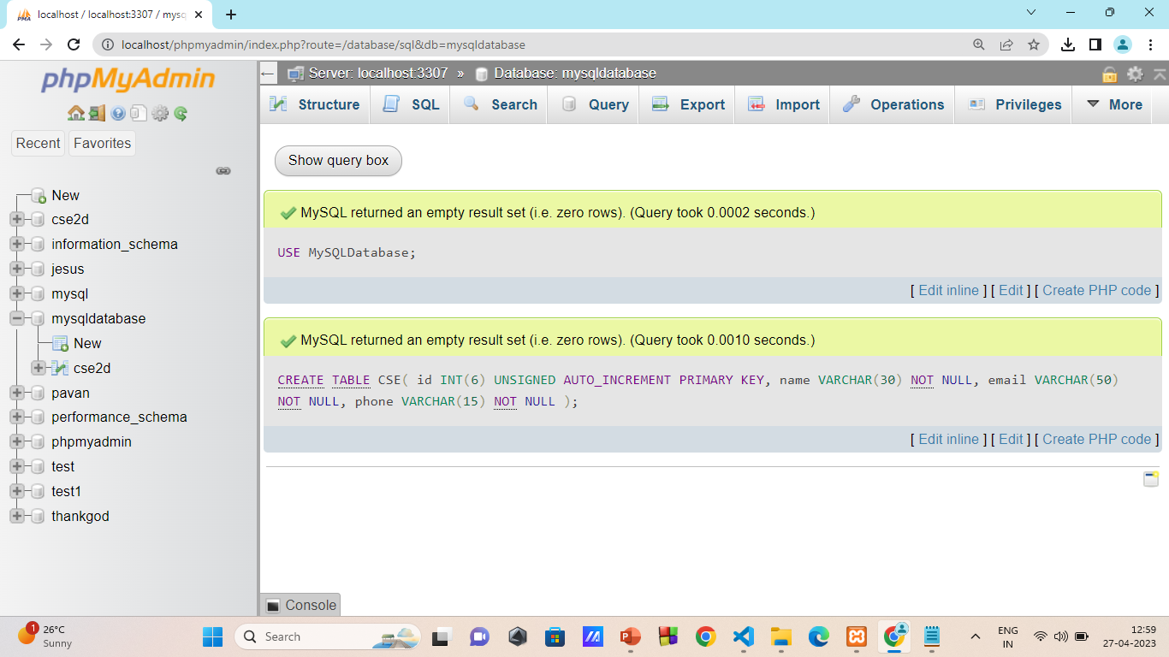
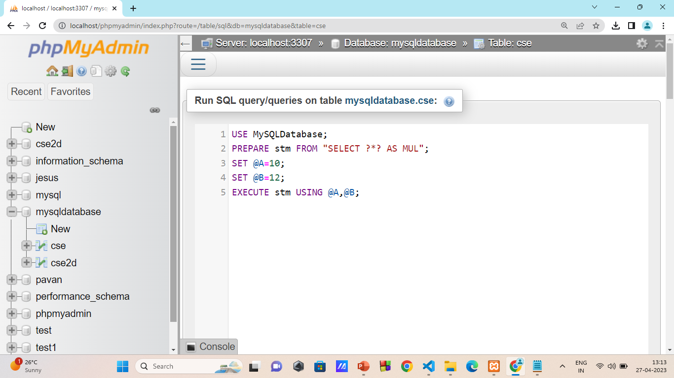
Execution:-

Slide 11

Inserting Data
To insert data into a table in SQL, you can use the INSERT INTO statement. Here's an example of inserting a customer named “CSE-2D" with email “CSE-2D@domain.com" and phone number “1234567890”:
Syntax:- INSERT INTO table_name (column1, column2, column3, ...) VALUES (value1, value2, value3, ...);
Query:- INSERT INTO CSE-2D (name, email, phone)
VALUES (‘CSE-2D’, ‘CSE-2D@domain.com', '123-456-7890’);

Slide 12
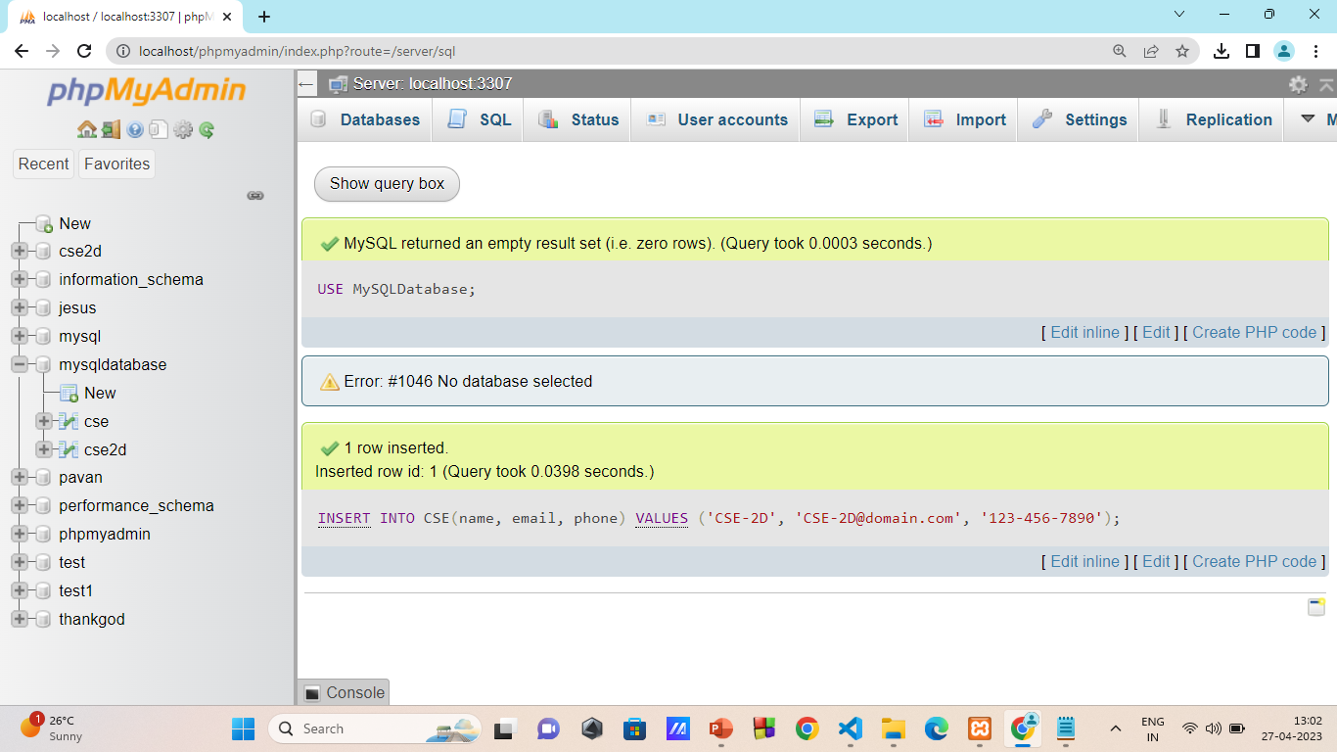
Execution1:-

Slide 13
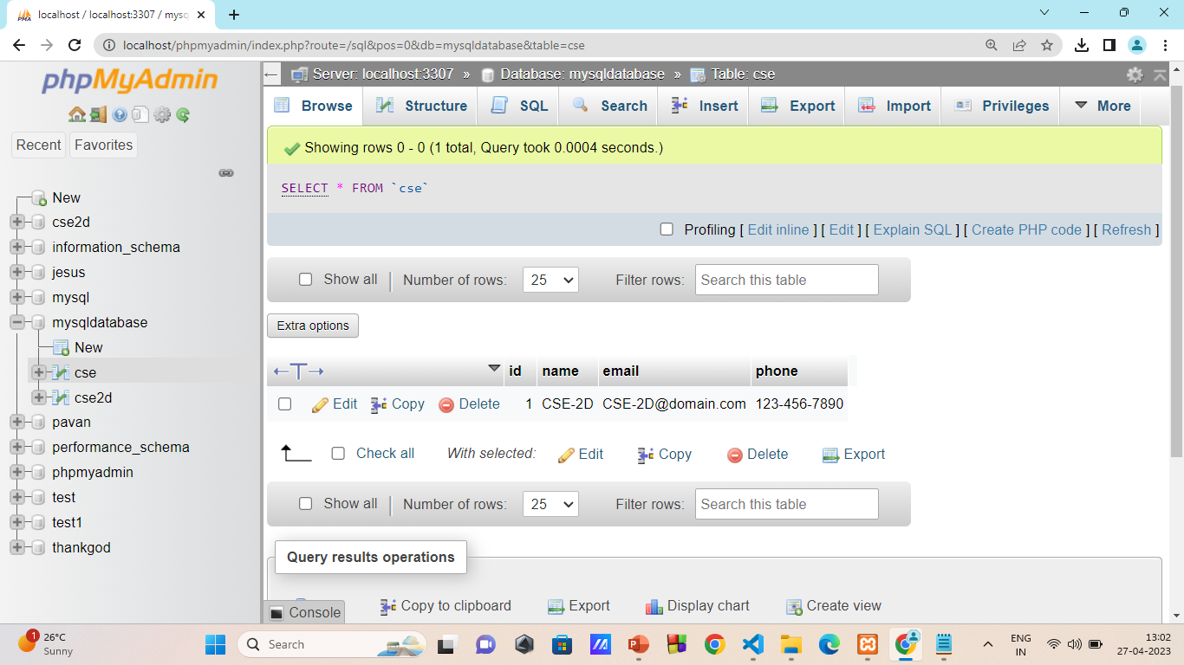
Execution2:-

Slide 14
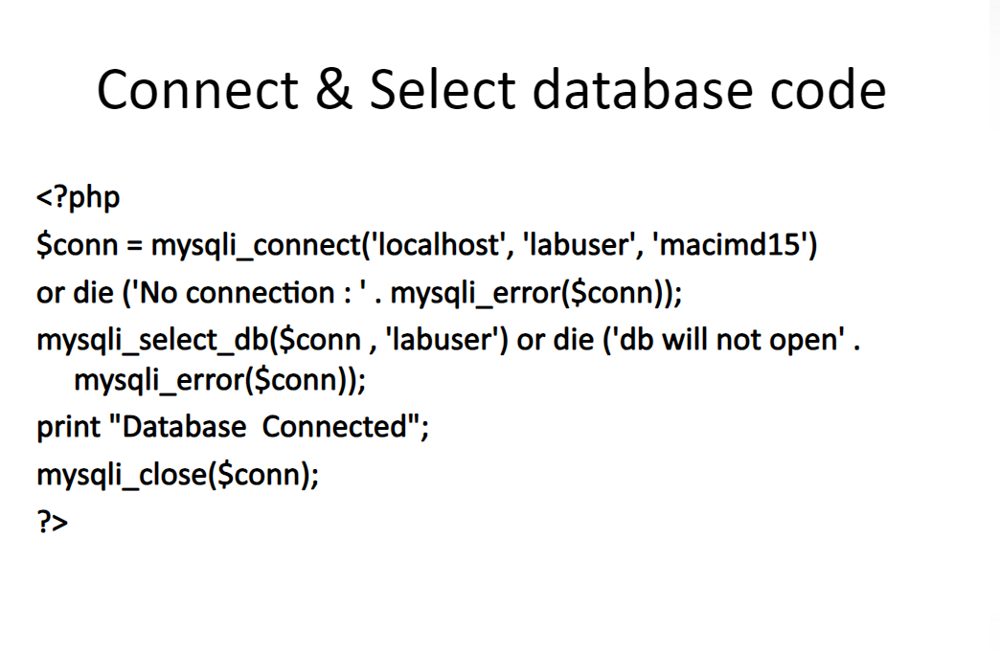

Slide 15
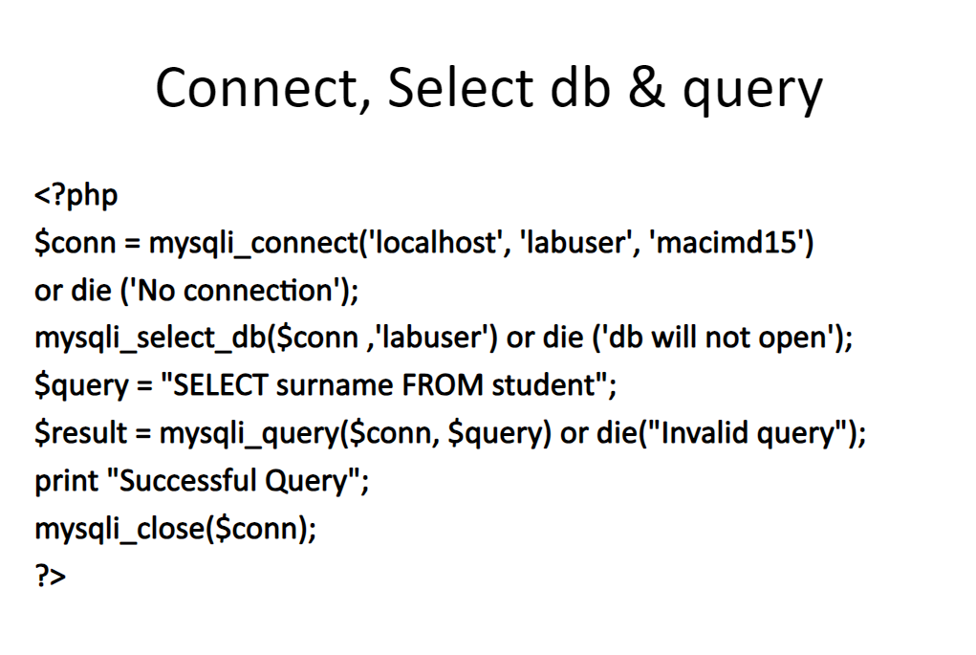

Slide 16
Reference: https://slideplayer.com/slide/7932008/

Slide 17
Prepared Statements
The MySQL database supports prepared statements. A prepared statement or a parameterized statement is used to execute the same statement repeatedly with high efficiency and protect against SQL injections.
In before of the MySQL version 4.1,before returning the result to the client, MySQL has fully parse the Query and converts the result into the String
Our Prepared Statement was introduced in MySQL version 4.1.
The main use of the prepared statements is to execute the same statement repeatedly with high efficiency
Prepared statements that contain a placeholder(?)
SELECT * FROM student WHERE id=?;

Slide 18
Basic Work Flow
The basic work flow of the prepared statement mainly consists of two stages.
A.PREPARE:- At the prepare stage, a statement template is sent to the database server.
In shortly, it prepares a statement for execution
PREPARE statement_name FROM “ Prepared_statement”;
B.EXECUTE Stage:- In this stage, the client binds parameter values and send them to the server.It will executes the query which already prepared by using PREPARE Statement
EXECUTE statement_name USING var1,var2

Slide 19
Basic Work Flow
C. DEALLOCATE/DROP Stage
It is the last and optional stage, which is used to release the prepared statement.
After droping the prepare statement, we cannot use it any more
DEALLOCATE PREPARE statement_name;

Slide 20
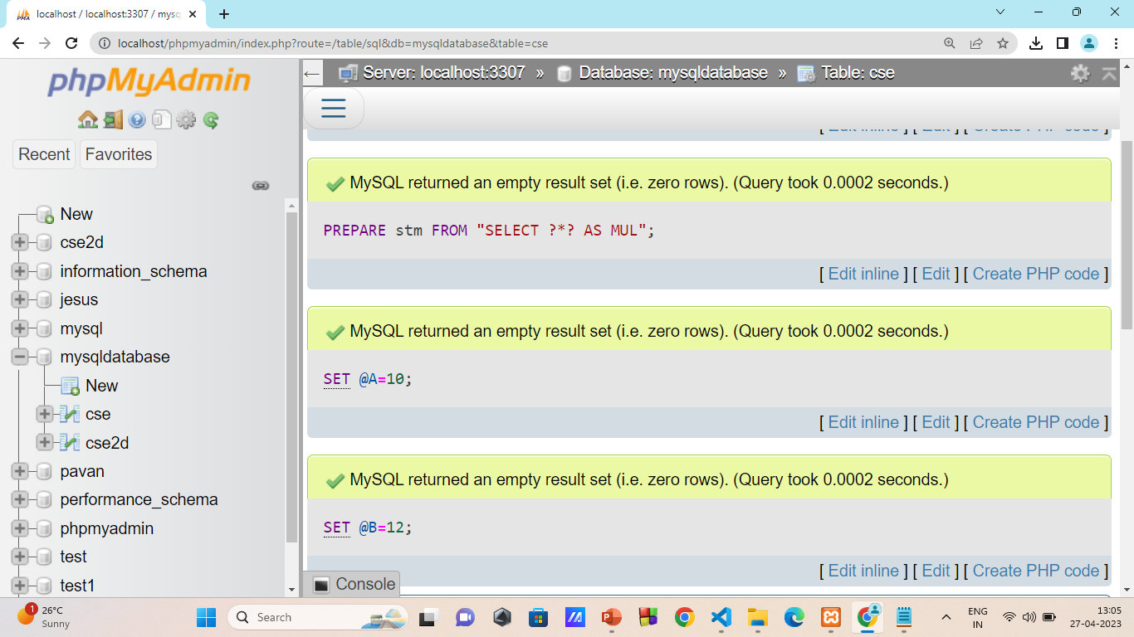
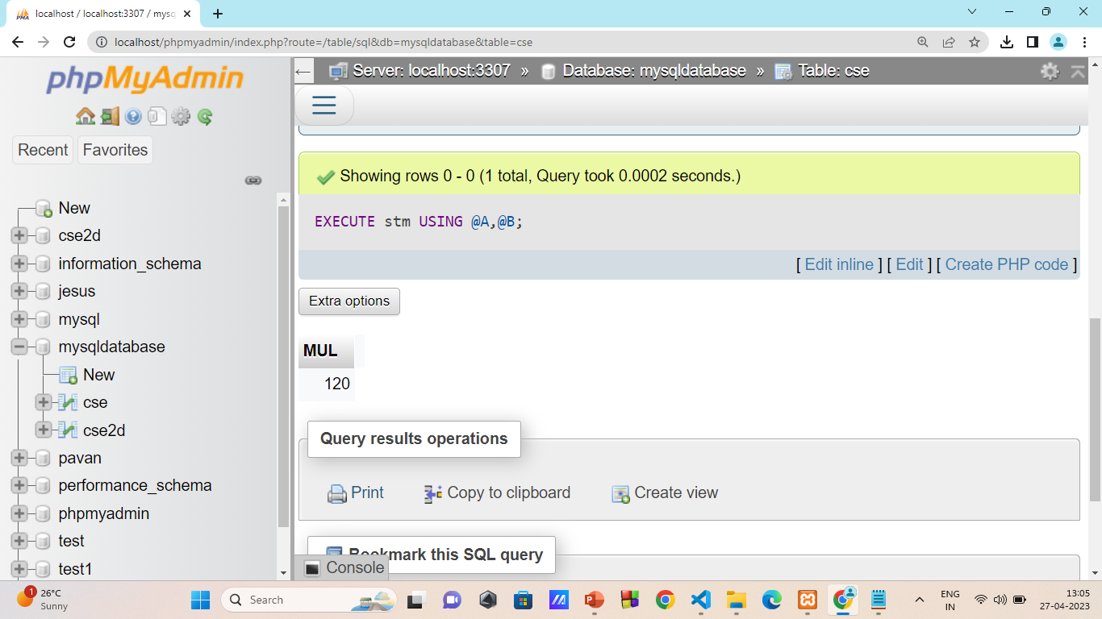
Execution:-

Slide 21
Key Points in Prepared Statements:-
Prepare Statements created in one session are not available for other sessions. When a session ends, whether normally or abnormally, its prepared statements are no longer exists in the memory.
Statement | Prepared Statement
It is used when we want to execute the SQL query only once | It is used when we want to execute the SQL query multiple times
It is static, which means we cant pass parameters at runtime | It is dynamic,which means we can pass the parameters at runtime
The performace execution is slow | The performance execution is fast
It doesnot prevent SQL Injection | It helps to prevent SQL Injection

Slide 22
NoSQL
NoSQL Database is a non-relational Data Management System, that does not require a fixed schema.
The major purpose of using a NoSQL database is for distributed data stores with humongous data storage needs.
They provide flexible schemas and scale easily with large amounts of data and high user loads.
NoSQL is used for Big data and real-time web apps.
NoSQL database stands for “Not Only SQL” or “Not SQL.

Slide 23
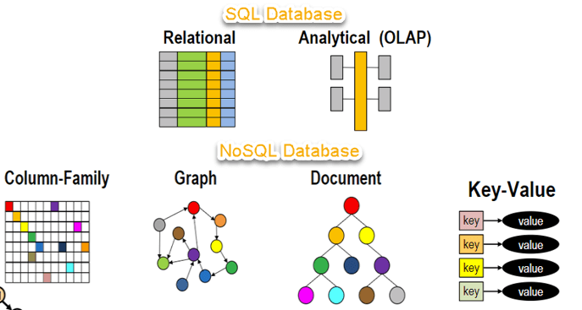

Slide 24
Why NoSQL?
The concept of NoSQL databases became popular with Internet giants like Google, Facebook, Amazon, etc. who deal with huge volumes of data.
The system response time becomes slow when you use RDBMS for massive volumes of data.
The alternative for this issue is to distribute database load on multiple hosts whenever the load increases. This method is known as “scaling out.”

Slide 25
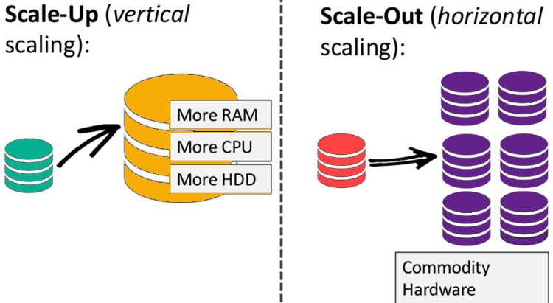

Slide 26
Brief History of NoSQL Databases
1998- Carlo Strozzi use the term NoSQL for his lightweight, open-source relational database
2000- Graph database Neo4j is launched
2004- Google BigTable is launched
2005- CouchDB is launched
2007- The research paper on Amazon Dynamo is released
2008- Facebooks open sources the Cassandra project
2009- The term NoSQL was reintroduced

Slide 27
Features of NoSQL
Non Relational
Schema free
Simple API
Distributed

Slide 28
Non-relational
NoSQL databases never follow the relational model
Never provide tables with flat fixed-column records
Doesn’t require object-relational mapping and data normalization
No complex features like query languages, query planners, referential integrity joins, ACID

Slide 29
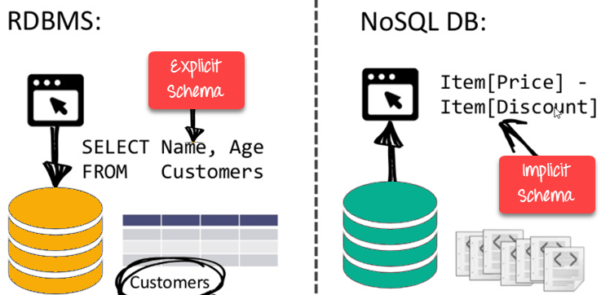
Schema Free
NoSQL databases are either schema-free or have relaxed schemas
Do not require any sort of definition of the schema of the data
Offers heterogeneous structures of data in the same domain

Slide 30
Simple API
Offers easy to use interfaces for storage and querying data provided
APIs allow low-level data manipulation & selection methods
Text-based protocols mostly used with HTTP REST with JSON
Mostly used no standard based NoSQL query language
Web-enabled databases running as internet-facing services

Slide 31
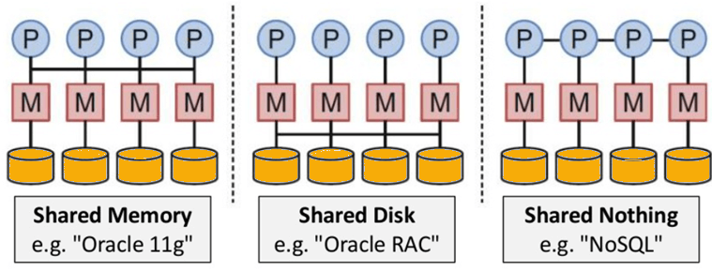
Distributed
Multiple NoSQL databases can be executed in a distributed fashion
Offers auto-scaling and fail-over capabilities
Often ACID concept can be sacrificed for scalability and throughput

Slide 32
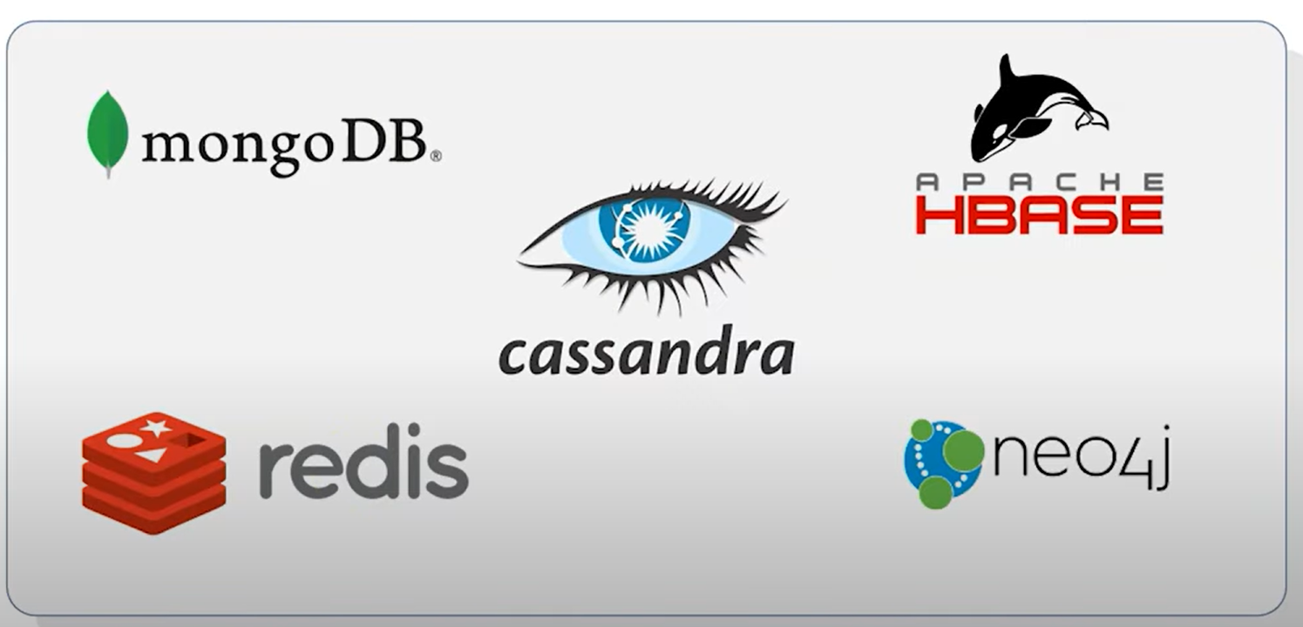
Popular NoSQL Databases:

Slide 33
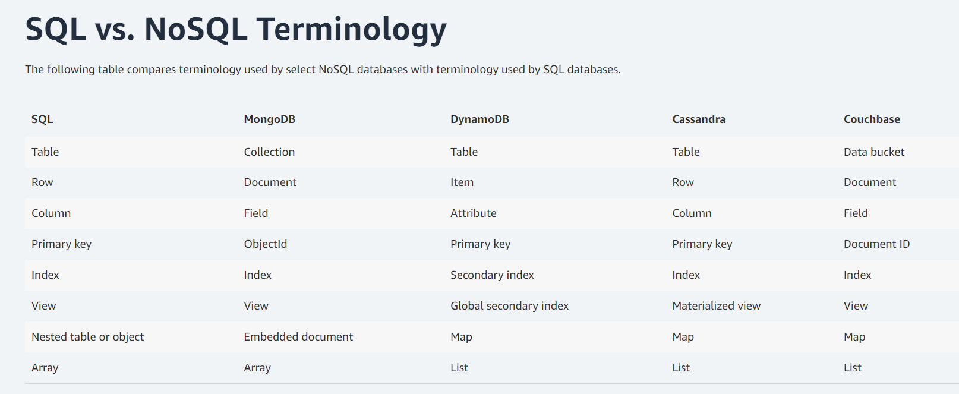

Slide 34
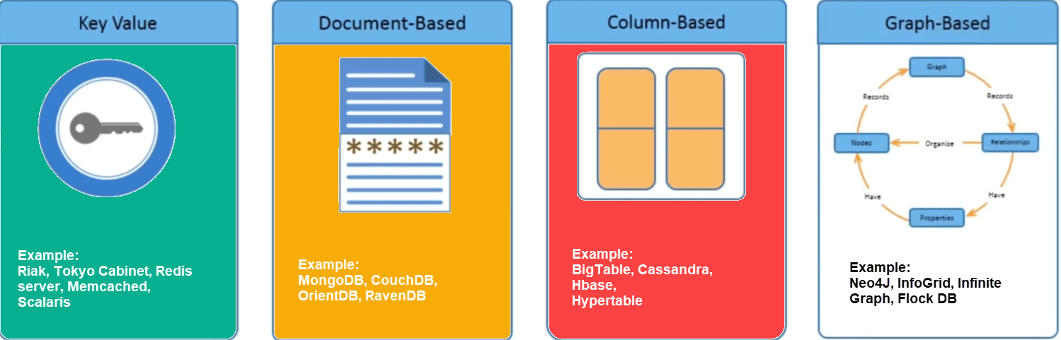
Types of NoSQL Databases
NoSQL Databases are mainly categorized into four types:

Slide 35
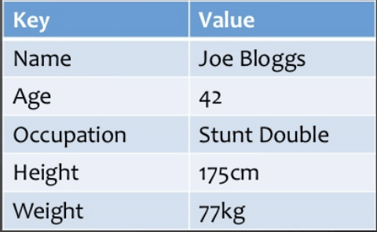
Key Value Pair Based
Data is stored in key/value pairs. It is designed in such a way to handle lots of data and heavy load.
Key-value pair storage databases store data as a hash table where each key is unique, and the value can be a JSON, BLOB(Binary Large Objects), string, etc.
Key value stores help the developer to store schema-less data. They work best for shopping cart contents.
A key-value store is like a relational database with only two columns which is the key and the value

Slide 36
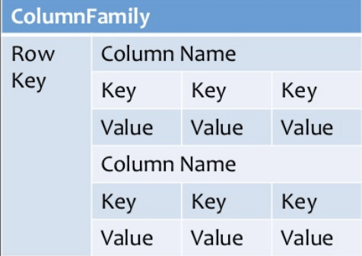
Column-based
A column-oriented database is a non-relational database that stores the data in columns instead of rows
Columnar databases are designed to read data more efficiently and retrieve the data with greater speed. A columnar database is used to store a large amount of data.
Examples of Column Databases:
Apache Cassandra
Hadoop HBase
HyperTable

Slide 37
Document-Based Database:
The document-based database is a nonrelational database. Instead of storing the data in rows and columns (tables), it uses documents to store the data in the database.
A document database stores data in JSON, BSON, or XML documents.
In the Document database, the particular elements can be accessed by using the index value that is assigned for faster querying.
Documents are schema-free and therefore are flexible and easy to modify.
Examples of Document Databases:
MongoDB
Couchbase
RavenDB

Slide 38
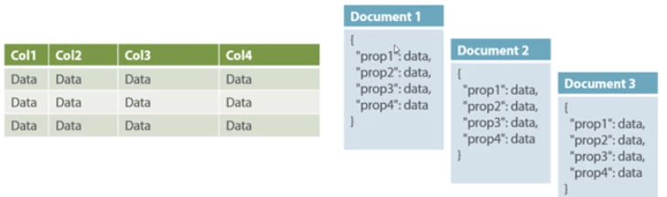

Slide 39
Graph-Based databases:
Graph-based databases focus on the relationship between the elements. It stores the data in the form of nodes in the database. The connections between the nodes are called links or relationships.
In a graph-based database, it is easy to identify the relationship between the data by using the links.
Example of graph databases:
FlockDB
HyperGraphDB
Neo4j

Slide 40
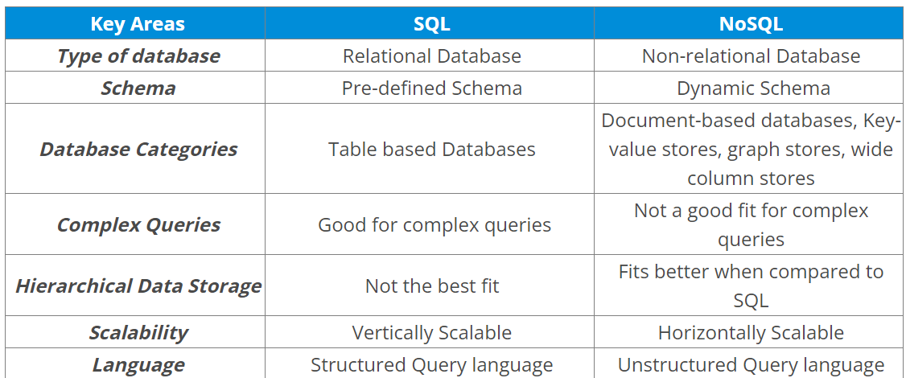
SQL vs NoSQL:

Slide 41
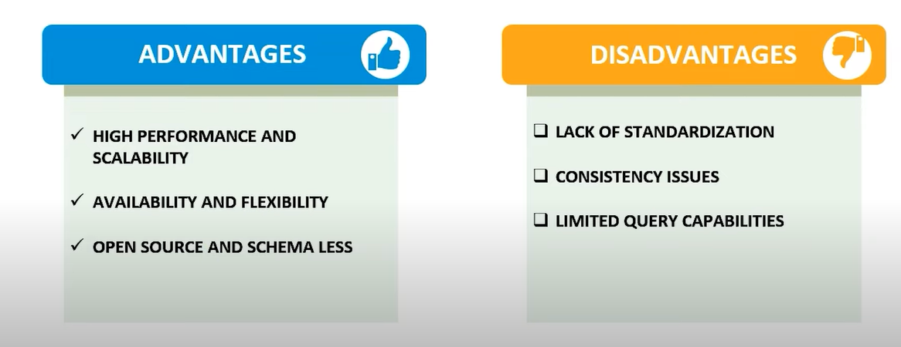

Slide 42
Query Mechanism tool of NoSQL
The REST-based retrieval of a value based on its key/ID with the GET resource is the most frequent data retrieval mechanism.
Because they grasp the value in a key-value combination, document store databases allow for more challenging searches. With MapReduce, CouchDB, for example, allows you to define views.

Slide 43
What is the CAP Theorem?
Brewer's theorem is another name for the CAP theorem. It claims that a distributed data store cannot provide more than two out of three guarantees.
1)Consistency
2)Availability
3)Partition Tolerance

Slide 44
1)Consistency: Even after an operation has been completed, the data should stay consistent. This indicates that once data is written, it should be included in any subsequent read requests. After altering the order status, for example, all clients should be able to see the same information.
2)Availability: The database should be accessible and responsive at all times. There should be no downtime.
3)Partition Tolerance: Partition Tolerance means that the system should keep working even if the connection between the servers isn't always reliable. The servers, for example, can be divided into several groups that may or may not communicate with one another. If one portion of the database is down, the other sections are always up and running.

